Slide 1
Advanced Games Development
Physics Engines 2
CO2301 Games Development 1
Week 21

Slide 2
Today’s Lecture
Joints
Degrees of Freedom
Joint Types
Compound Joints / Rag-dolls
Considerations for Characters

Slide 3
Joints
A joint in a physics engine is defined as a constraint on the motion of a body
  The body can not move freely and is constrained in some way
  Constraints can be angular or linear
    I.e. limit is on rotation or translation
There are several kinds of joint, each specified by:
  The degrees of freedom (d.o.f.) allowed for the body
  The limits imposed on these degrees of freedom
Most physics engines provide some standard joint types for simplicity…
…and a generic joint type for more unusual setups

Slide 4
Degrees of Freedom
The degrees of freedom for a body is the number of values required to uniquely specify its position / orientation, e.g.:
  A 2D sprite that can’t rotate has two linear d.o.f. : X and Y
  If it can rotate, then it has three, X, Y (linear) and α (angular)
  A 3D object has six: X, Y, Z for position and α, β, γ for rotation
Different joints have different numbers and types of degrees of freedom
What different kinds of standard joint are there, and what degrees of freedom do they have?

Slide 5
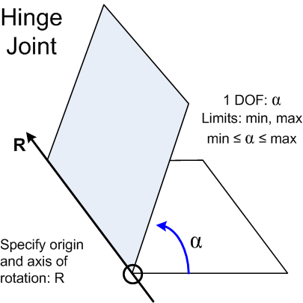
Hinge Joint
A hinge is one of the simplest joints
It has only one degree of freedom
  Rotation round an axis
We define the hinge with this axis:
  Give a point on the axis (the origin of the hinge)
  And the axis vector
Easy to set limits on the angle of rotation

Slide 6
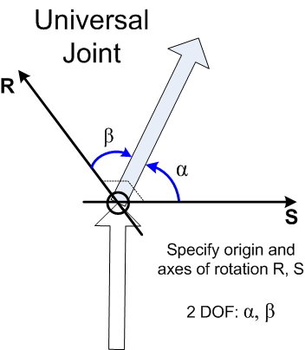
Universal Joint
A universal joint is a more general rotational joint
  Drive train or steering on a car uses this type of joint. Allows rotation to “go round corners”
Two degrees of freedom:
  Rotation round 2 fixed axes
  Note, the body cannot twist
  α and β can be constrained to a cone (see later)
Specified by:
  Rotational origin
  Two axis vectors

Slide 7
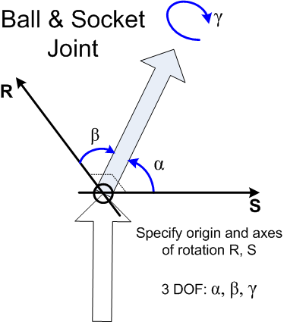
Ball and Socket Joint
The most general rotational joint
  Like our upper arm or upper leg sockets
Three degrees of freedom:
  Rotation around 3 fixed axes
  α and β can be constrained to a cone
  The twist angle γ is often limited
Specified by:
  Rotational origin
  Three axis vectors

Slide 8
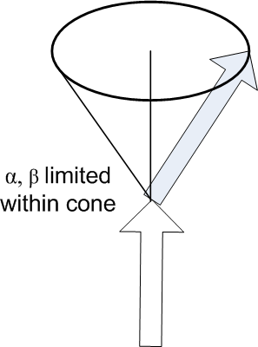
Cone Limits
For the universal and ball-socket joint it is less obvious how to apply rotational limits
A simple method is to define a cone within which the jointed object can move
This cone puts natural limits on the angles α and β
Cone is defined by:
  Axis direction
  Radius (or radii)

Slide 9
Other Joints
Those joints limited translation & only allowed rotation
Less obvious joint types have some translation freedom:
Slide Joint:
  One d.o.f.: linear translation along an axis
  Define the axis origin and direction
  The linear movement is trivially limited
Similar 2D & 3D slide joints
Complex joints, e.g. a corkscrew joint:
  Two d.o.f., one linear translation along an axis, combined with rotation around the same axis
  The translation and rotation are linked
  Defines a corkscrew or screw-thread movement

Slide 10
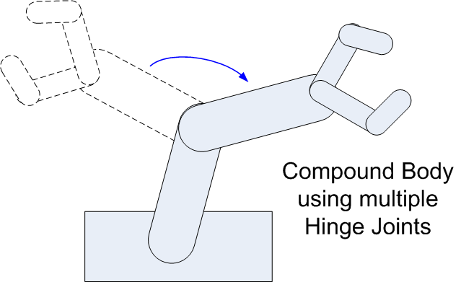
Compound Joints
Simple joints may connect a body to the world
Create compound bodies using multiple joints
For each joint we define the parent and child body
Defines a jointed hierarchy
A rag-doll (a jointed figure) is a common use of complex compound body
What joints make up a rag-doll?

Slide 11
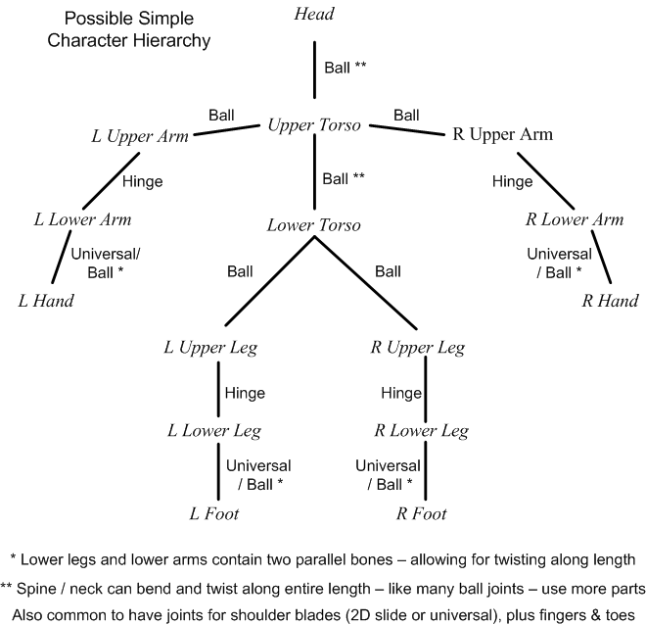
Rag-Doll Joints
One possible rag-doll setup
Many other possibilities
Would be limits on all the d.o.f.

Slide 12
Characters in Physics Engines
When using a physics engine, control of models becomes indirect – using forces, impulses etc.
But we need direct control of player characters
This causes conflict, e.g.:
  If I run into a pillar, should I bounce off or stop?
  Different decisions from player control code and physics
Also we may get unwanted effects from physics
  Character topples over
  Can’t climb stairs (it’s a mini wall!)
  Problems with friction
  Etc.

Slide 13
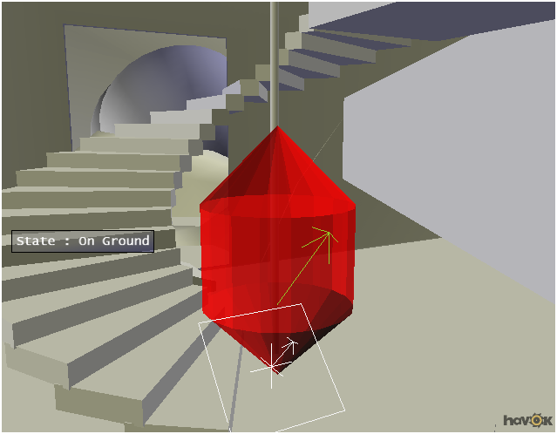
Characters in Physics Engines
Some physics engines provide special bodies and APIs for controlling characters
  Allows user to set velocities, instead of using forces
  Typically a capsule or similar shape
  But doesn’t fall over
Rounded shape smoothes movement round objects
Shape of base allows movement up stairs

